Slide 1
THE BATTLE OF NEIGHBOURHOODS ============================= FINDING THE BEST NEIGHBORHOODS TO OPEN A RESTUARANT OF PARTICULAR CUISINE NEAR OFFICES IN THE BAY AREA
IBM Data science Professional Certificate Capstone Report
OLANREWAJU YUSUF – 30 JUNE, 2020

Slide 2
BUSINESS PROBLEM
The main objective behind the idea is to find the best spot for the next profitable restaurant business in the Bay Area.
The Bay Area has a lot of restaurants with different cuisines including Mexican, Italian etc .
Starting a restaurant without analysis won’t yield good results

Slide 3
DATA ACQUISITION
The bay area companies list was used for the analysis. the dataset was extracted from github and was open source. The .csv file was downloaded to notebook and was imported to pandas data frame from the. The link to the github data source is provided in the report

Slide 4
DATA SCIENCE METHODOLOGY
The data was extracted and cleaned, and the feature selection was made
Map for all the offices in the bay area was plotted
Foursquare API was used to figure out the nearest restaurants
The restaurants were classified using KMeans ML algorithm
The clustered restaurants were plotted along with the companies in the Bay Area

Slide 5
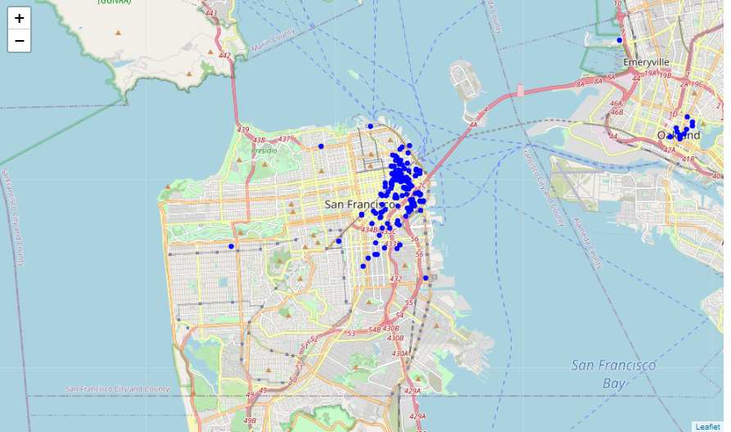
Map of all companies in the Bay area

Slide 6
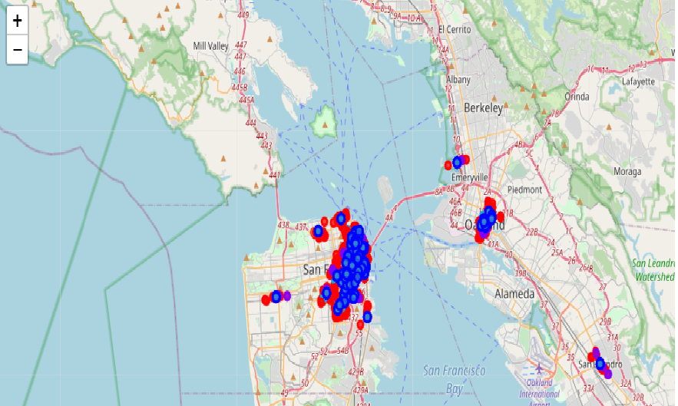
Map of all the restaurant clusters along with the company

Slide 7
RESULTS
Clusters | Colors | Restaurant Cuisine
0 | Red | Mexican, sushi, Mediterranean, etc
1 | Purple | Vietnamese
2 | Light Blue | New American
3 | Green | French
4 | Orange | Japanese

Slide 8
CONCLUSION AND OBSERVATION
The Mexican and New American cuisine restaurants are very less near the Cadre Talent office.
In the East Bay region, there is neither an Italian nor a new American restaurant.
In the San Leandro region, there is no New American restaurant, so opening one might be a good idea.
Many other observations can be made before starting a restaurant business from the analysis performed.

